Slide 1
A Recommendation System for restaurant Contractors

Slide 2
Part 1- problem description
Restaurant contractors specialize in managing the supply chain for restaurants in consumables like groceries, bakery items, fruits, dairy products and other consumables.
Contractors in Toronto would like to see which areas in Toronto have high revenue potential
The objective is to explore the areas in Toronto holding huge earning potential where their services could be used to full extent
The contractors would also like to focus on the North York area of Toronto and examine areas in and around the neighborhood of North York which provides more service opportunities.
The contractors want to build a storage unit for the groceries they buy from villagers and farmers inside the borough and also reduce the transportation costs for the Restaurant owners with Transportation logistic services

Slide 3
Who would be interested in this project
Restaurant managers in Toronto would like to explore the Toronto area to see what kind of venues exist and what kind of restaurants will be suitable for the neighborhood
Transportation service providers would like to see which areas in Toronto would need time crucial transportation services especially perishables
Residents of Toronto would like to know about the kind or restaurants available in Toronto and know where specialty restaurants like Thai Restaurant or Vietnamese restaurants are available
Residents of North York, Toronto would like to see the most common venues in their area

Slide 4
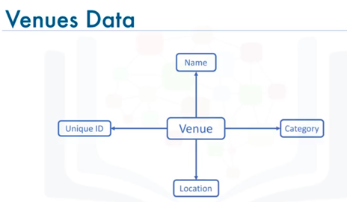
Part 2 - DATA description
Wikipedia :
https://en.wikipedia.org/wiki/List_of_postal_codes_of_Canada:_M
Is used to collect information about Toronto neighborhoods and their postal codes
Geospatial coordinates csv file of the neighborhoods using the Geocoder package, having geographical coordinates of each postal code: http://cocl.us/Geospatial_data
https://api.foursquare.com api is used to
get Location details like venues

Slide 5
Thank you

